Slide 1
Template V2 Training
Supply Chain Inbound
Manufacturing

Slide 2
Concepts and Basic Terminology
Resources
Master Recipes
Operations / Phases
Production Version
Planned Order
Process Order
Goods Receipt
Confirmation / Backflush
Actual Consumption
Control Recipes
Scrap / Rework

Slide 3
Glossary
Atlas Terminology Currently known as
Resource - Work Centre
Master Recipe - Routing (Includes Process Instructions & Specs)
Process Order - Work Order
Material - Item, Product, Ingredient, Component
Operations - Op Codes
Phases - Sub-Operations
Process Instructions
and Control Recipes - MCL’s, MPI’s
BOM - List of Ingredients

Slide 4
What is a resource ?
A resource is a piece
of equipment that is
used to make
something
Resource
An example would be
the main bar line
in Snackfood

Slide 5
What is Master Recipe ?
A Master Recipe is
the definition of a
process.
A MR contains
Operations, each of
which utilises a
single Resource
Resource
Master
Recipe
An operation can
have multiple
phases, all of which
happen on the resource
of the operation
A number of things can happen in
an operation or a phase, including:
- Addition of a component
- Execution of a process instruction

Slide 6
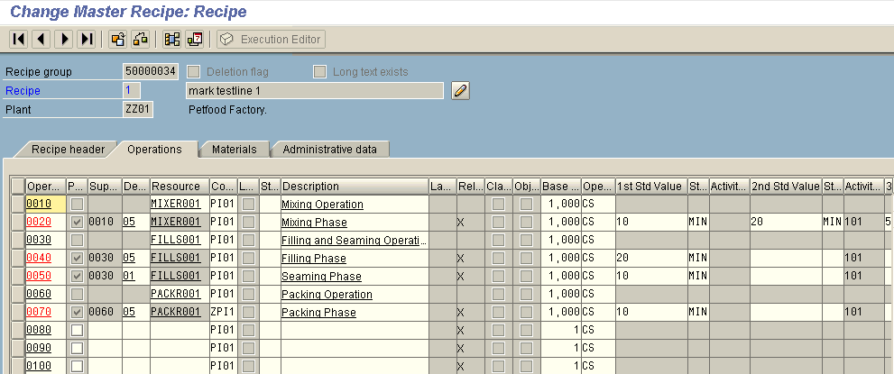
Operations and Phantoms

Slide 7
What is A BOM Structure?
A BOM structure is a
structured list of
components required
to make a material
A BOM Structure
contains a number of
discrete BOMs, where a
BOM is a single level
list of components
required to make a
material
Resource
Master
Recipe
BOM

Slide 8
What is a Production Version?
A Production Version
indicates that we can
use a master recipe
to make a material
A Production Version
is first linked to a
master recipe
Resource
It is then linked to a
BOM, at the material
produced level
Master
Recipe
Production
Version
Last but not least the operations and
phases where materials are used
are indicated in the production
version.
BOM

Slide 9
What is A Planned Order?
A Planned Order is a
recommendation to
make a quantity of a
material, on a date,
using a production
version
Resource
Master
Recipe
Production
Version
A Planned Order will
react to changes in
the Master Recipe,
and or BOM
BOM
Planned
Order

Slide 10
What is A Process Order?
A Process Order is a
commitment to make a
quantity of a material by
performing operations on
specific resources
using specific components
A Process Order is
NOT linked to the
PV, MR, or BOM
It is a snapshot at
the time it was
created
Resource
Master
Recipe
Production
Version
BOM
Planned
Order
Process
Order

Slide 11
BOM Source
TDU
Case
Planned
Stocked
MCU
PALE
PACK
Show Box
Printed Tray/Box...
Not Planned
Not Planned
Planned
Not Stocked
Not Stocked
Stocked
RSU
PACK
PACK
PACK
Bar/Can/Bag...
Printed Box
Case/Tray...
Shrinkfilm
Not Planned
Planned
Planned
Planned
Not Stocked
Stocked
Stocked
Stocked
NLAG
PALE
PACK
NAKE
Printed Label/Wrapper
Not Planned
Not Planned
Planned
Not Stocked
Not Stocked
Stocked
RAWS
NLAG
RAWS
PACK
PACK
Semi-finished
Ingredient
Can
End
Planned
Not Planned
Planned
Planned
Planned
Stocked
Not Stocked
Stocked
Stocked
Stocked
The Nake part of the BOM structure is sourced from RADAR.
RAWS
RAWS
Semi-finished
Ingredient
Planned
Planned
The packaging part of the BOMstructure is keyed directly into ATLAS
Stocked
Stocked
RAWS
RAWS
The product Chain is maintained as part of the GRD
Semi-finished
Ingredient
Planned
Planned
Stocked
Stocked

Slide 12
Order Lifecycle
Sequencing
System
Planning System
Planned Orders
Convert
to Process Order
Physical
Production
Goods receipt
Confirm
Items produced
Process Order
Enter
Actual consumption
Close Order

Slide 13
Order Lifecycle
External
Sequencing
System
External
Planning System
Planned Orders
Convert
to Process Order
Physical
Production
Goods receipt
Confirm
Items produced
Process Order
Enter
Actual consumption
Close Order

Slide 14
Planned Orders
A Planned Order is a recommendation to make a material.
The planned order specifies:
  The date it is to be manufactured
  The quantity
  The Production Version, which addresses
    TDU BOM alternative
    The production line (Master Recipe)
  It may have been created manually, by the MRP or
  from an external system. (eg. Apollo,SKEP,PPS).

Slide 15
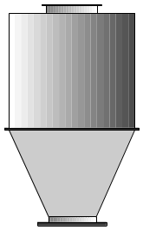
Planned Orders
Planned Order
Production line 1
Packing
1kg bag
Packing
500g bag
Semi-finished
Production line 2
Planned Order
Packing
1kg bag
Planned Order
Planned Order
Notes:
Depending on the set up of the individual factory we can have one level or multiple (usually 2 level) planned orders.
If the production process has just one point where product is stored and counted (palletiser) we would have just a planned order for the finished product.
If the production line is split into a processing part where the naked product is stored and counted, and a packing part we would have one planned order for the semi finished good and a planned order per packing line.

Slide 16
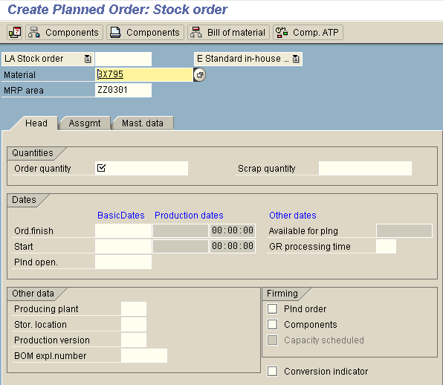
SAP Planned Order - Transaction MD11

Slide 17
Order Lifecycle
External
Sequencing
System
External
Planning System
Planned Orders
Convert
to Process Order
Physical
Production
Goods receipt
Confirm
Items produced
Process Order
Process Order
Enter
Actual consumption
Close Order

Slide 18
Process Orders
When we decide to firm up the Planned Order, we convert it to a Process Order however in exceptions a Process Order could be created manually.
The Process Order is a definition of what we are going to make, when we are going to make it, where we are going to make it, and the materials we are going to use to make it.

Slide 19
Release Process Orders
    The releasing of Process Orders signifies that
    production may now commence against these
    orders.
    Prior to the release, no actual costs & Confirmations
    can be posted against these orders.
In ATLAS V2, the release of a Process Order
generates a Control Recipe that can be sent to
an FDS/MES system and will result in the
creation of a PI Sheet where required.
Once released, material reservations are created.

Slide 20
Functions of Process Orders
Collects the costs of
  Activities (through confirmation of activities)
  Materials (through consumption movements)
Drives demand of Procurement
(thru Process Order Reservation)

Slide 21
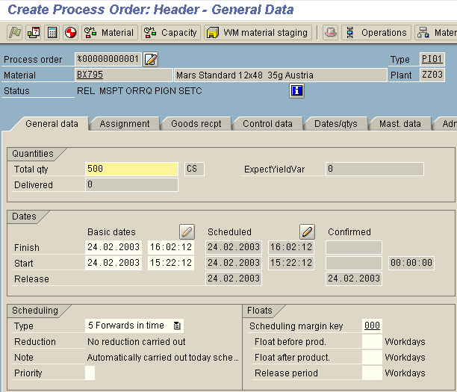
SAP Process Order - Transaction COR7

Slide 22
Order Lifecycle
External
Sequencing
System
External
Planning System
Planned Orders
Convert
to Process Order
Physical
Production
Goods receipt
Confirm
Items produced
Process Order
Enter
Actual consumption
Close Order

Slide 23
Control Recipes
If the interface to a process control system (MES) is
activated, a Control Recipe is created after the order
release and sent to its destination.
The Control Recipe consists of process instructions.
Either they send information required by the MES or
they request data from the MES for the upload to
SAP.
Alternatively, the information from the Process
Instructions can be sent to a PI Sheet where the data
is entered manually.

Slide 24
Integration with MES
Process
Instruction
(PI) Sheet
Planned Order
Process Order
Control Recipe
SAP
MES
Interface to MES
Notes:
Based on the functionality provided by PP/PI a so called control recipe will be created during the conversion of a planned order to a process order.
The control recipe can provide information to production in two ways:
Via PI-Sheets on a SAP screen
Via interface to Manufacturing Execution Systems (MES) – Planned for V3
In V2 of ATLAS we provide PI-Sheets for the facilitation of the production recording process.

Slide 25
Order Lifecycle
External
Sequencing
System
External
Planning System
Planned Orders
Convert
to Process Order
Physical
Production
Goods receipt
Confirm
Items produced
Process Order
Process Order
Enter
Actual consumption
Close Order

Slide 26
Goods Receipt
Advice to the system about the output from the Process Order,
typically a pallet of Finished Goods.
Thereby resulting in an increase of stock of FG and SFG.
(i.e no impact on Raws or Packs).
Goods Receipt are performed
  per pallet (goods handling unit) in automated factories
  per x pallets depending on shipment frequency in
  non-automated factories.
Final GR is required with the last material produced by
the order.

Slide 27
Production Confirmation
The confirmation of production:
  Allocates the Activity cost to the Process Order.
  Updates the stock of used materials (Raws, Packs) if the material is flagged to be backflushed.
The confirmation will be done once per shift (usually at the end) or at the end of the run if it completes earlier.
Notes:
After a process order has been released for production, the results of its execution are documented in form of the confirmation and the posting of goods movements.
A confirmation documents the processing status of process orders, their operations, phases and individual capacities. Therefore confirmations are used to monitor the progress of process orders.
They record the consumed quantities, the actual dates, and the activities and resource capacities needed.
Depending on the configuration of the recipe and the process order type, the confirmation leads to an automatic goods receipt and withdrawal postings for (backflushed) components.
Alternatively, the consumed goods can be posted directly (actual consumption)
In order to enhance MRP relevant updates for the expected production and consumption, the process order (or its phases) may be partially confirmed, f.i. pallet by pallet. .
Backflush - this takes the materials on the COMPONENT LIST that are flagged to be consumed by backflush (as opposed to being reported via actual material consumption) and multiplies it by the quantity of the output material receives (material receipts), and automatically consumes these materials.

Slide 28
Order Lifecycle
External
Sequencing
System
External
Planning System
Planned Orders
Convert
to Process Order
Physical
Production
Goods receipt
Confirm
Items produced
& Backflush
Process Order
Process Order
Enter
Actual consumption
Close Order

Slide 29
Backflushing
ATLAS will calculate material consumption (Raws, Packs) and update the stock levels for the materials used based on the BOM quantities.
This method is called “backflushing”.
Backflushing does not reflect the quantities used in reality. Difference will be captured by physical Inventory counts.
Notes:
A backflushing indicator is set in the material master and resource – this will be decide at each site for each line and material.

Slide 30
Order Lifecycle
External
Sequencing
System
External
Planning System
Planned Orders
Convert
to Process Order
Physical
Production
Goods receipt
Confirm
Items produced
Process Order
Process Order
Enter
Actual consumption
Close Order

Slide 31
Actual Consumption
In some cases the amount of a specific material
used will be known accurately, in these cases
we will utilise actual material consumption to record
what has been used.
The material will not be backflushed.
The advantages of recording actual material
consumption will be:
  Accurate inventory usage.
  Timely inventory usage.
  Accurate recipe variance.

Slide 32
Order Lifecycle
External
Sequencing
System
External
Planning System
Planned Orders
Convert
to Process Order
Physical
Production
Goods receipt
Confirm
Items produced
Process Order
Enter
Actual consumption
Close Order

Slide 33
Close Process Orders
At the end of the production the Process
Order needs to be closed
Closure of Process Orders is undertaken to:
  Balance Goods Receipt and confirmation
  quantities
  Ensure that stock is correctly updated
  Ensure the order can be costed and settled
  Close down outstanding demand for component
  It is sometimes necessary to close some
  Process Orders even if the quantity made is lower
  than the quantity planned.
Notes:
During the course of a production run, it will from time to time become necessary to close process orders prior to the them being completed.
When this occurs, it is possible that due to the different frequency of goods receipting and confirmation , that there will be quantities that have been goods receipted against an order, but not confirmed.
It is proposed that to close a process order in this status , the order be finally confirmed with a quantity that will reconcile the difference between the quantity goods receipted against an order and the confirmed quantity.
Mention bespoke. Used for Confirmqtion and to close the Process Order also.

Slide 34
Order Lifecycle
External
Sequencing
System
External
Planning System
Planned Orders
Convert
to Process Order
Physical
Production
Goods receipt
Confirm
Items produced
Process Order
Enter
Actual consumption
Close Order

Slide 35
Atlas Material Type Definitions
FERT
  finished product
  can be a traded unit (TDU) e.g. case or RSU (bar)
  stocked items
ROH
  raw material (single entity) e.g. Granulated Sugar
  semi finished product ( SFPR ) e.g. chocolate
  ROH’s are stocked items
NLAG
  sub recipe (SREC)
  non stocked (e.g. gravy)
VERP
  packaging material (e.g. case , wrapper)
  stocked items

Slide 36
Stockable v Non-Stockable Materials
Stockable Materials
They are Planned (and are created by an External Planning
system) or created by MRP. e.g. Finished Goods, Kibble or
Chocolate.
Non-Stockable (Phantom) Materials
A material which is produced as a transient within the
manufacturing process. e.g. Nougat, Gravy.
It is not held in inventory, we do not tell the system that it has
been made, or consumed.
They are generally created within the system to reduce the
effort required in BOM maintenance, where lower level items
are susceptible to frequent change in their specification.
They are not included in Planned/Process Orders.

Slide 37
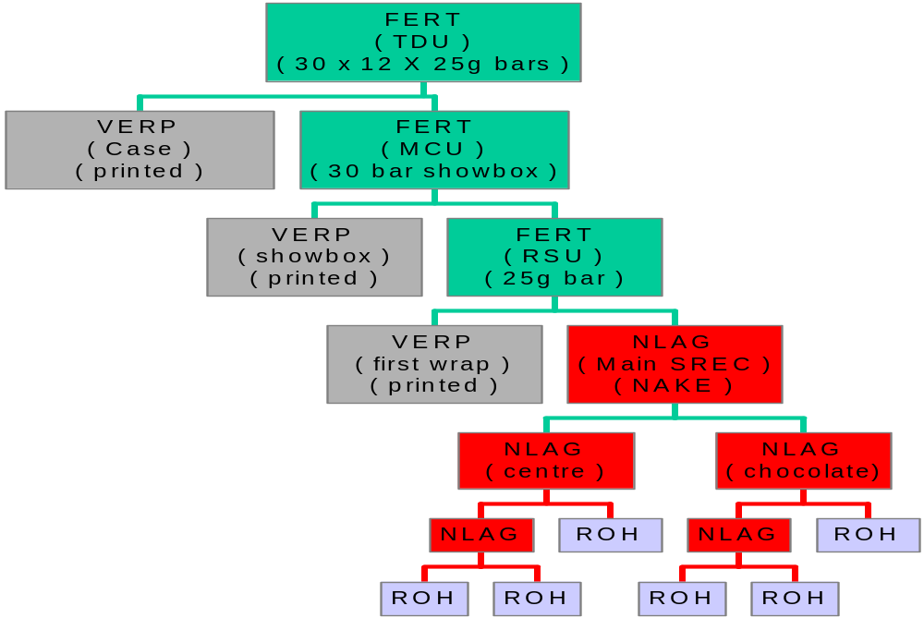
Stockable vs Non-Stockable Materials

Slide 38
Manufacturing
Material Rework & Scrapping

Slide 39
Scrapping Material
Process used to record materials that are scrapped in the manufacturing environment
Simple and complex “scrapping” examples
  Simple - Individual ingredient or packaging item that is lost in production or handling
  Complex - Semi-finished item in the midst of processing
Notes:
The general rule is that scrap should be accounted for on an event basis (when it happens) or at least be summarised each shift

Slide 40
Reasons for Scrapping Materials
There are a number of events that may result in scrap creation:
  Changeovers
  Equipment failure
  Batching errors
  Line flushing at clean-up
  Line trials
  Material quality issues
  Start up
Notes:
To supplement continuos improvement efforts, reason codes will be used when recording scrap, to aide in identifying why and where the scrap occurred within the factory
Scrap materials are weighed, counted or collected in standardised bins as a measurement of manufacturing losses. The location of the scrap generation is identified. A reason code is assigned to the scrap.
Goods Movements are generated in ATLAS to appropriately record the physical collection of scrap. These movements will provide a quantification of the volume and cost of scrap generated throughout the manufacturing process and will deplete material inventories to facilitate requirements planning

Slide 41
Scrap Scenarios
3 Scrap Scenarios
1. Scrap from Stock
2. Scrap from a Production Line - link to Process Order
3. Scrap from a Production Line - no link to a Process Orders

Slide 42
3. Scrap from production line with no link to process orders
This can occur if scrap has been collected
throughout a shift that contained multiple process
orders.
As with the previous scenario, we need to record a
Goods Issue of the Raws based on the Recipe
usage at the relevent process step.
Costs are allocated against a scrap Cost Centre
Notes:
Eg. Where several Process Orders can run simultaneoulsy on a Production line. If enrobing stage on a snack bar line causes scrap - unable to determine the PO therefore

Slide 43
Scrap
    Regardless of the scenario, a Reason
    Code may be assigned to assist in identifying the
    cause of the scrap as information for CIP.
Atlas uses a custom (bespoke) program -
“/mars/scrap_rework” to record scrap &
rework.

Slide 44
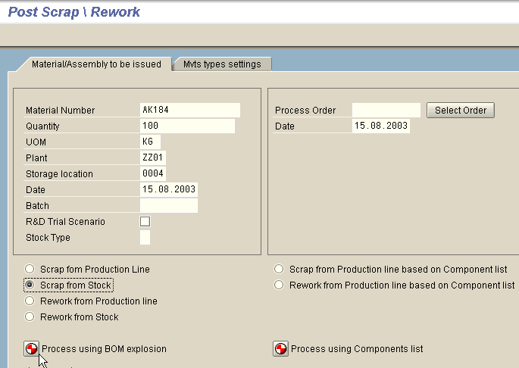
Scrap and Rework Bespoke

Slide 45
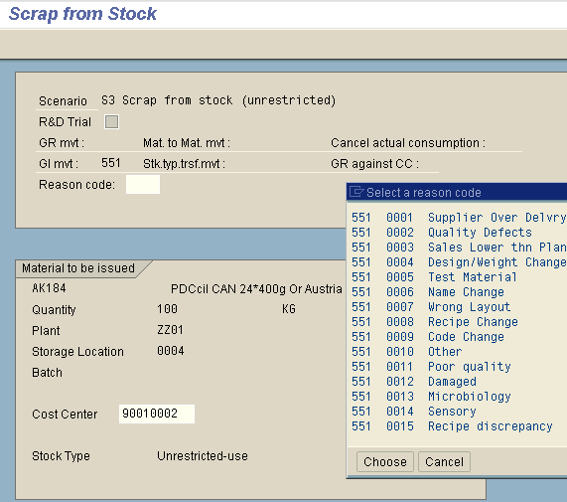
Scrap and Rework bespoke

Slide 46
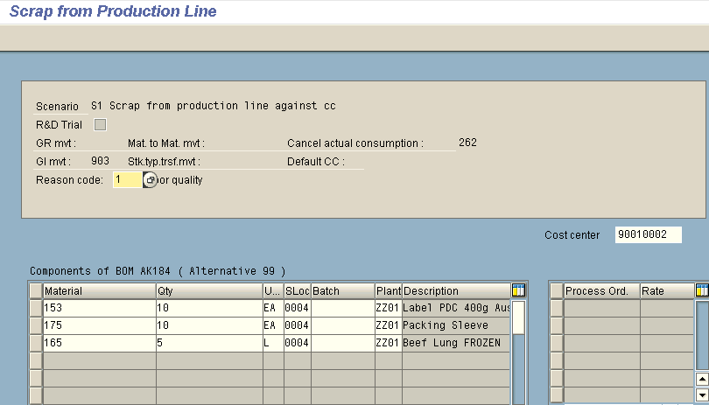
Scrap and Rework Bespoke

Slide 47
Rework Material
Material which is not converted properly into finished goods during the production run
“Excess” material
  Some of this excess material can be recovered in a sanitary environment and then reprocessed
Material managed in this fashion is generally referred to as “Rework”
Notes:
Based on the manufacturing processes of a given site, rework may be managed as a stockable item (where a perpetual inventory of the rework is managed) or as a non-stockable item (where the rework inventory is not managed, but is recognised to effectively record the ingredients consumed by it - commonly known as a phantom item).

Slide 48
Rework Scenarios
As with Scrap, there are 3 main Rework Scenarios (with some variations)
1. Rework from Stock (after Goods Receipt)
2. Rework from a Process Order (prior to Confirmation).
3. Rework from Production Line with no link to a Process Ord.

